Slide 1
Introduction to AI / ML and Deep Learning by using TensorFlow
16.03.2021

Slide 2
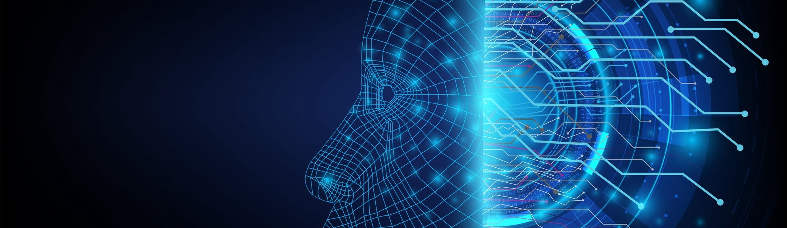
Introduction to AI / ML and Deep Learning by using TensorFlow
16.03.2021

Slide 3
Agenda
Transfer Learning
Saving and Loading Models
Teachable Machine

Slide 4
Intro of AI / ML and Deep Learning
Intro of Google Colab
Intro of TensorFlow 2.x
Practical
Convert Celsius Temp into Farhnite Temp
Image Classification with Fashion MNIST Dataset

Slide 5
Intro of CNN – Convolutional Neural Network
Convolution
Pooling
Practical
Image classification with Fashion MNIST Dataset by using CNN
Image classification with Cat vs Dogs Dataset by using CNN

Slide 6
Transfer Learning
A technique that reuses a model that was created by machine learning experts and that has already been trained on a large dataset.

Slide 7
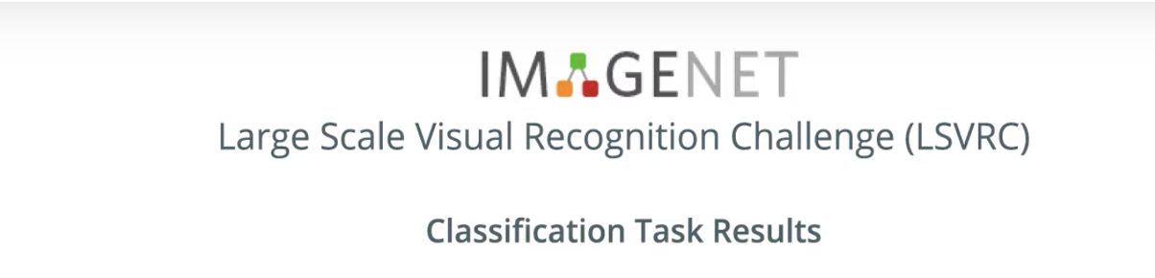
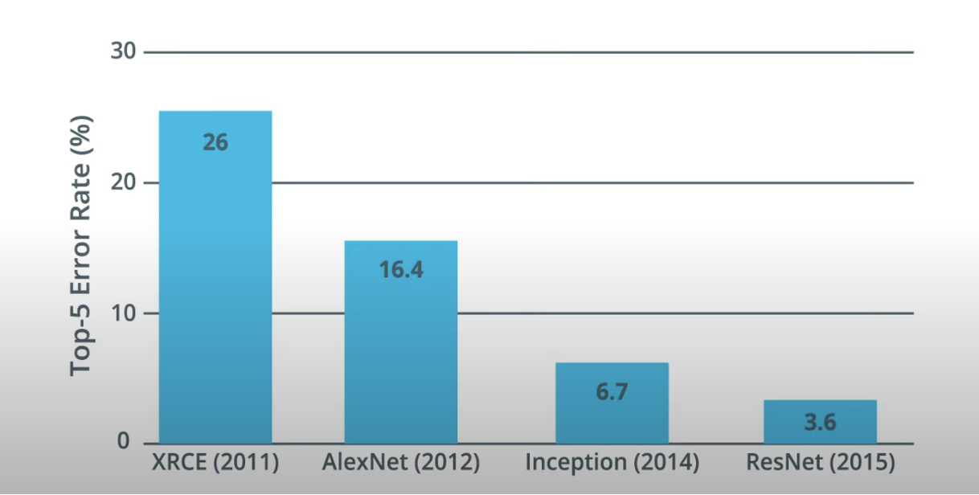
Transfer Learning

Slide 8
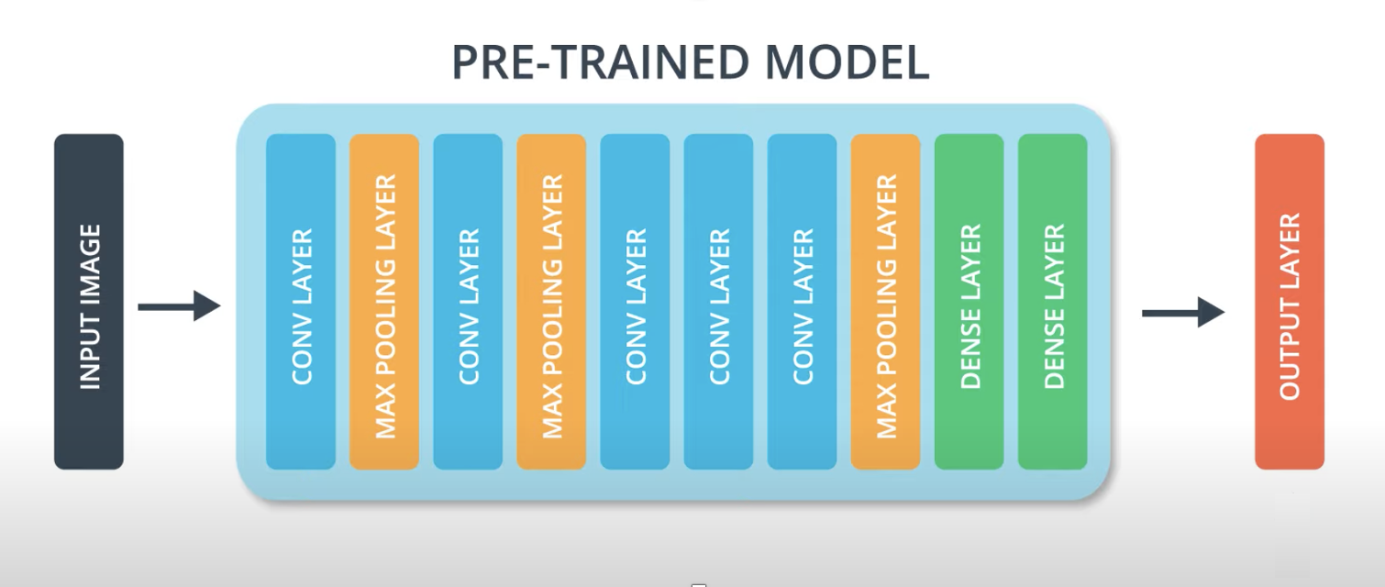
Transfer Learning

Slide 9
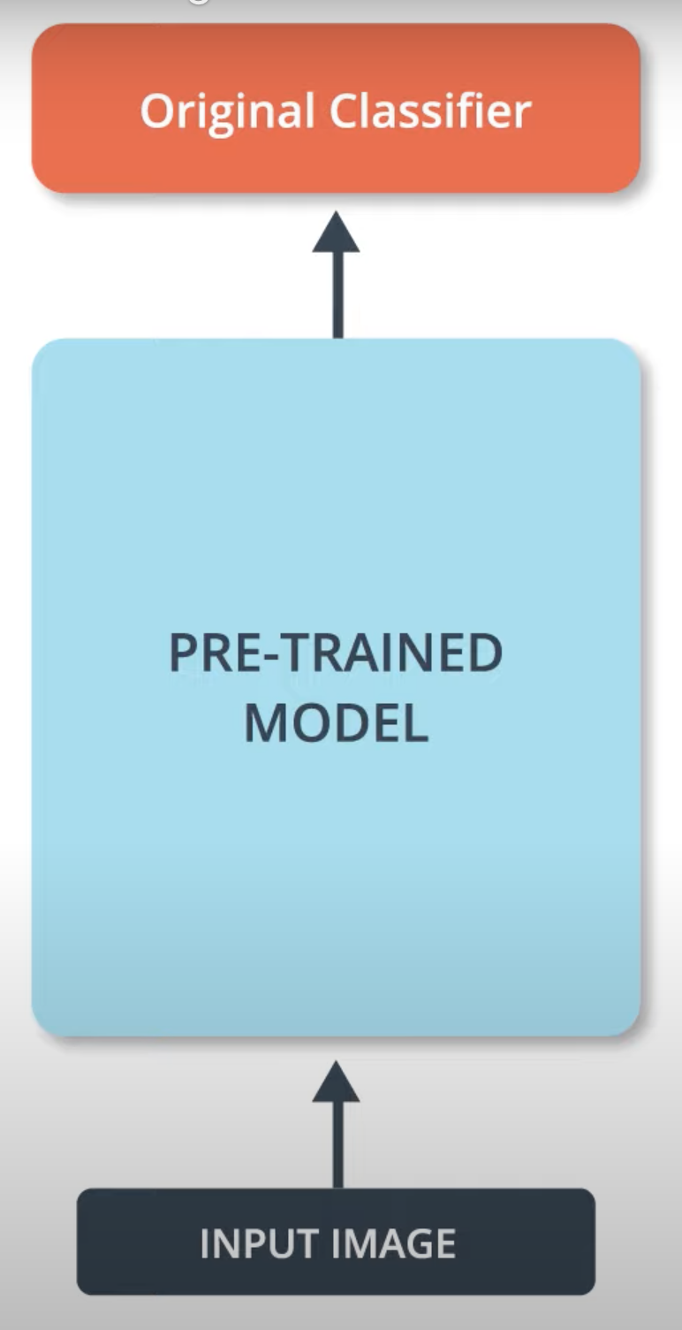
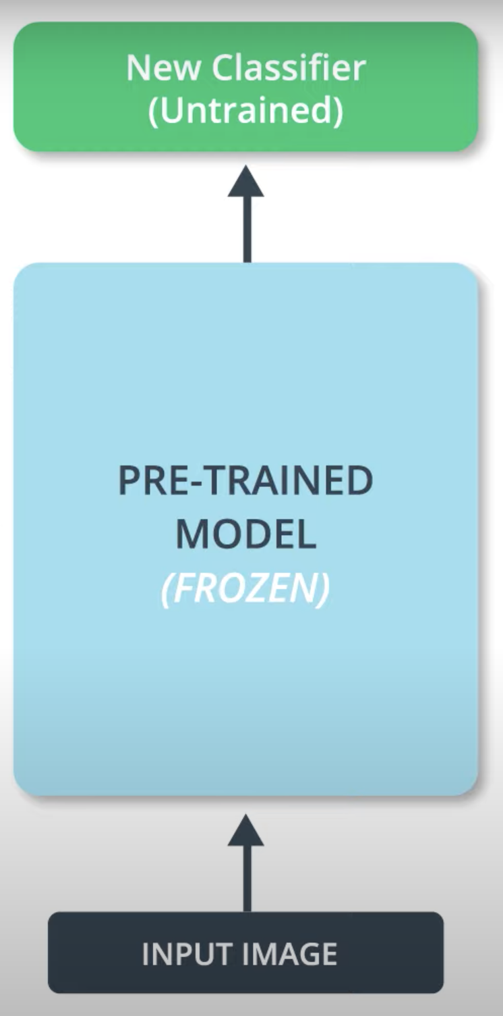
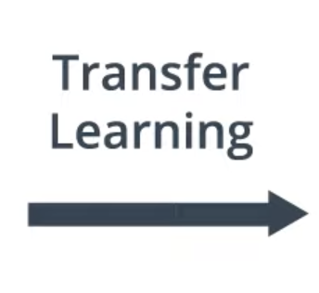
Transfer Learning

Slide 10
MobileNet
A state of the art Convolutional Neural Network called MobileNet.
MobileNet uses a very efficient neural network architecture that minimizes the amount of memory and computational resources needed while maintaining a high level of accuracy.
Due to this we can use MobileNet on low memory devices i.e. Mobile

Slide 11
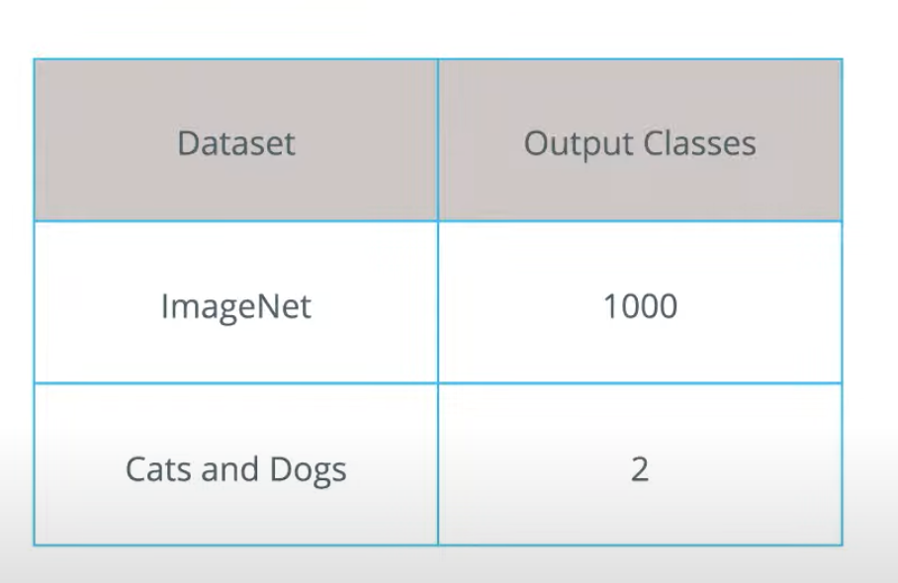
MobileNet
Developed by Google

Slide 12
https://www.tensorflow.org/hub
TensorFlow Hub
It is a repository of pretrained models.
It also has pretrained models without a classification layer.

Slide 13
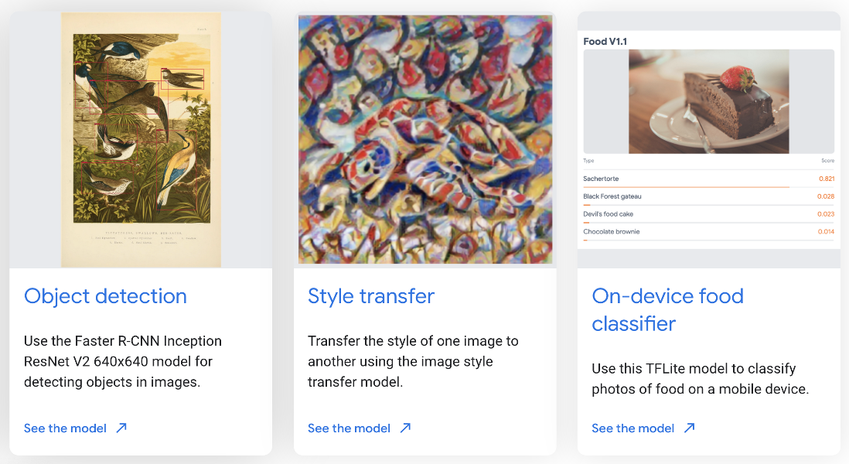
https://www.tensorflow.org/hub
TensorFlow Hub

Slide 14
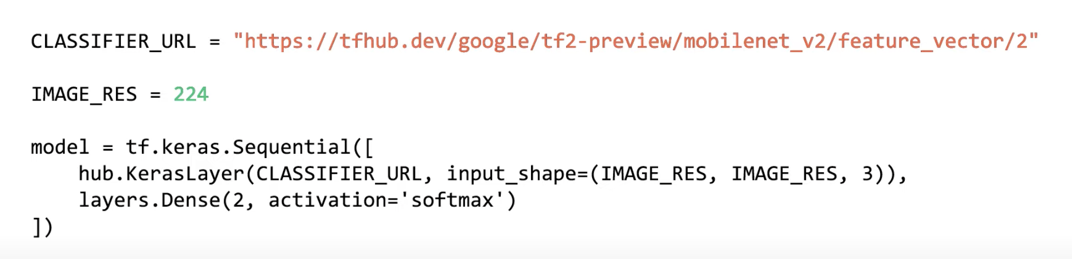
Existing pretrained Model
Transfer Learning – Create Model
Use Existing Pretrained Model
Add classification layer

Slide 15
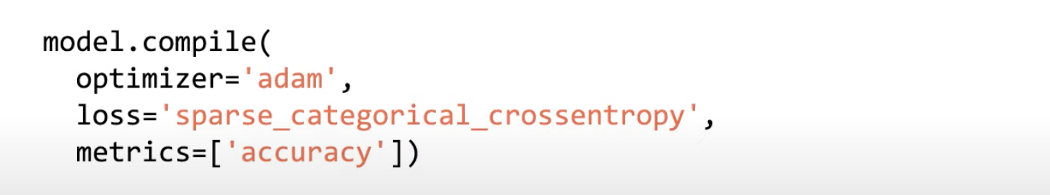
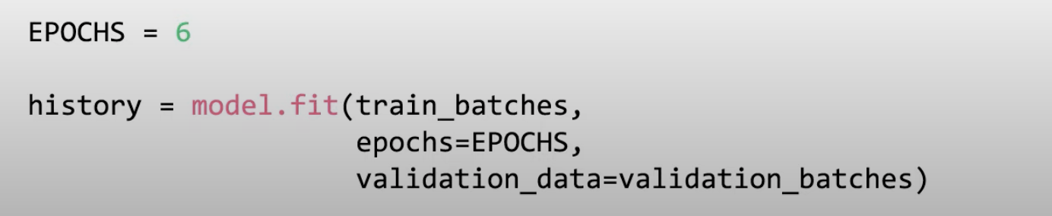
Transfer Learning – Compile and Train Model

Slide 16
Transfer Learning – Practical
Use a TensorFlow Hub MobileNet for prediction
https://github.com/DineshChopra/AI-ML/blob/master/TensorFlow/Transfer_Learning_1.ipynb
Use a TensorFlow Hub models for the Cats vs. Dogs dataset
https://github.com/DineshChopra/AI-ML/blob/master/TensorFlow/Transfer_Learning_2.ipynb
Do simple transfer learning with TensorFlow Hub
https://github.com/DineshChopra/AI-ML/blob/master/TensorFlow/Transfer_Learning_3.ipynb

Slide 17

Transfer Learning

Slide 18
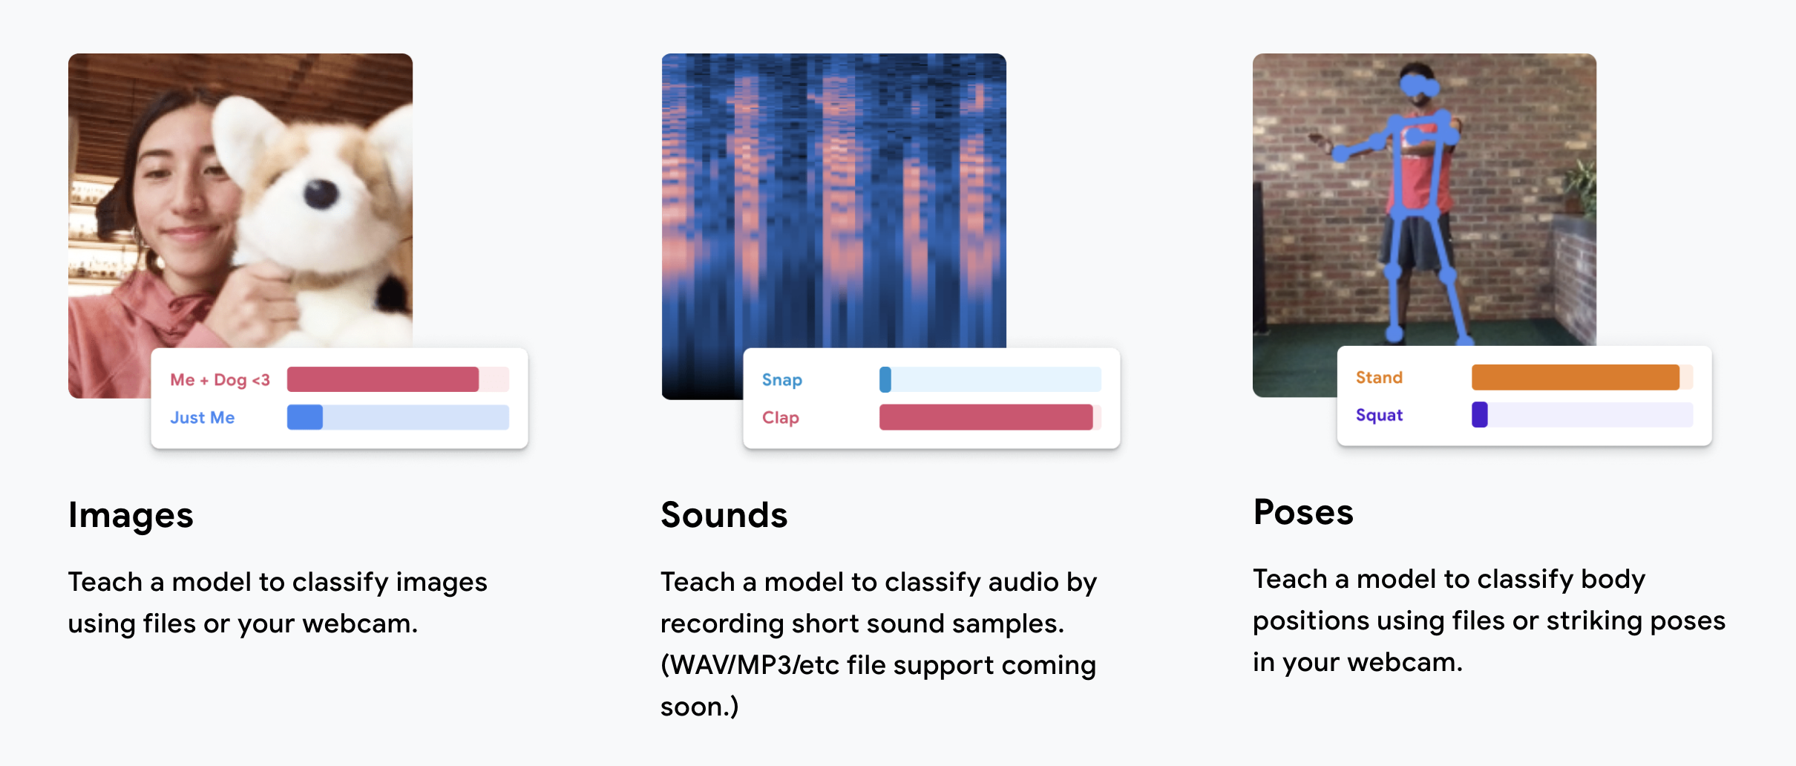
Teachable Machine

Slide 19
Teachable Machine
Sample
https://teachablemachine.withgoogle.com/
Code
https://codelabs.developers.google.com/codelabs/tensorflowjs-teachablemachine-codelab/index.html#0

Slide 20
Teachable Machine – Practicle
How to load pretrained Mobilenet Model and make a prediction on new data.
How to make prediction through the webcam.
How to use intermediate activation of Mobilenet to do transfer learning on a new set of classes you define on the fly with the webcam.
https://github.com/DineshChopra/AI-ML/tree/master/TeachableMachine

Slide 21
Teachable Machine
Load TensorFlow.js and MobileNet Model
<html> <head> <!-- Load the latest version of TensorFlow.js --> <script src="https://cdn.jsdelivr.net/npm/@tensorflow/tfjs"></script> <script src="https://cdn.jsdelivr.net/npm/@tensorflow-models/mobilenet"></script> </head> <body> <div id="console"></div> <!-- Add an image that we will use to test --> <img id="img" crossorigin src="https://i.imgur.com/JlUvsxa.jpg" width="227" height="227"/> <!-- Load index.js after the content of the page --> <script src="index.js"></script> </body> </html>

Slide 22
index.js
Teachable Machine
let net; async function app() { console.log('Loading mobilenet..'); // Load the model. net = await mobilenet.load(); console.log('Successfully loaded model'); // Make a prediction through the model on our image. const imgEl = document.getElementById('img'); const result = await net.classify(imgEl); console.log(result); } app();

Slide 23
Teachable Machine
Install http-server npm module: npm install –g http-server
Download grace_hopper.jpg image from:
https://storage.googleapis.com/download.tensorflow.org/example_images/grace_hopper.jpg
Create folder images and save grace_hopper.jpg image into it

Slide 24
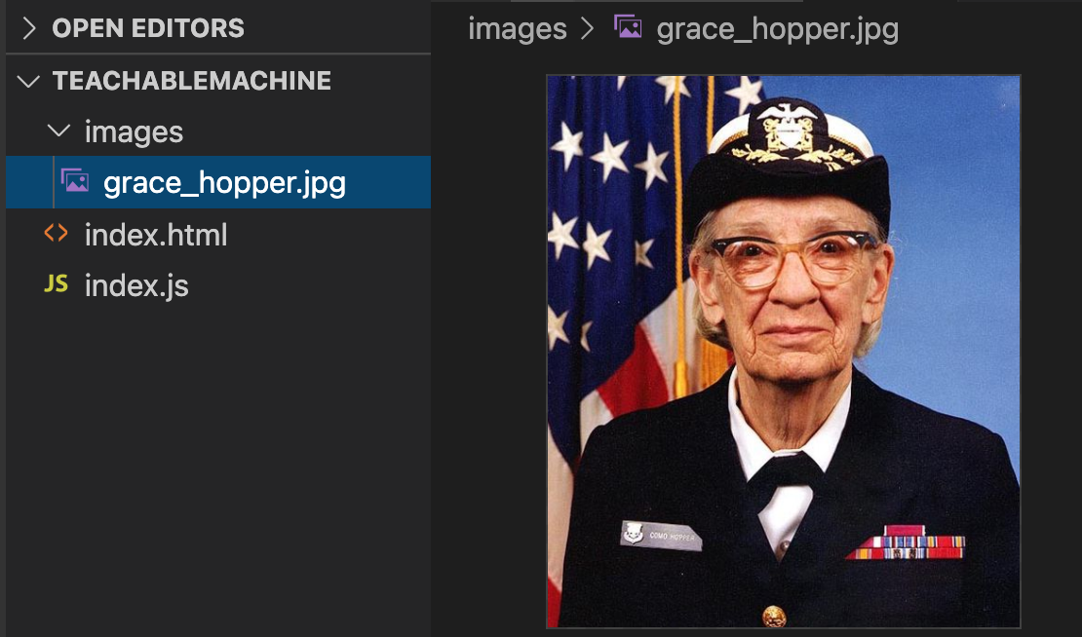
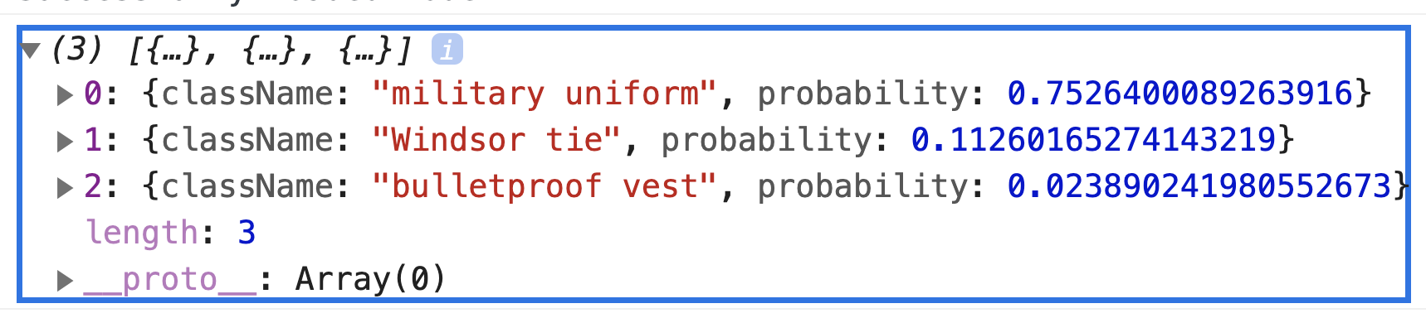
Teachable Machine
https://github.com/DineshChopra/AI-ML/tree/master/TeachableMachine/part1

Slide 25
Summary
Transfer Learning
Saving and Loading Models
Teachable Machine

Slide 26

Resources
https://www.udacity.com/course/intro-to-tensorflow-for-deep-learning--ud187
Free Course
TensorFlow.js Teachable Machine, Transfer Learning Image Classifier
https://codelabs.developers.google.com/codelabs/tensorflowjs-teachablemachine-codelab/index.html#0
Understanding Convolution-network with Visualizations
https://towardsdatascience.com/understanding-your-convolution-network-with-visualizations-a4883441533b

Slide 27

Resources
Tutorial
https://www.tensorflow.org/tutorials/keras/classification
https://colab.research.google.com/github/tensorflow/docs/blob/master/site/en/tutorials/keras/classification.ipynb#scrollTo=9ODch-OFCaW4
https://www.udacity.com/course/intro-to-tensorflow-for-deep-learning--ud187
Free Course
How Neural Network Works ?
https://www.youtube.com/playlist?list=PLZHQObOWTQDNU6R1_67000Dx_ZCJB-3pi
MIT Introduction to Deep Learning | 6.S191
https://www.youtube.com/watch?v=njKP3FqW3Sk&list=PLtBw6njQRU-rwp5__7C0oIVt26ZgjG9NI

Slide 28



Slide 29


Slide 30
REVISION HISTORY
Rev No. | Date | Description of Change | Author | Review and Approved By
1.0 |  | Initial Draft | Dinesh Chopra | Tanmoy B (L&D)
2.0 |  |  | Dinesh Chopra

